Slide 1
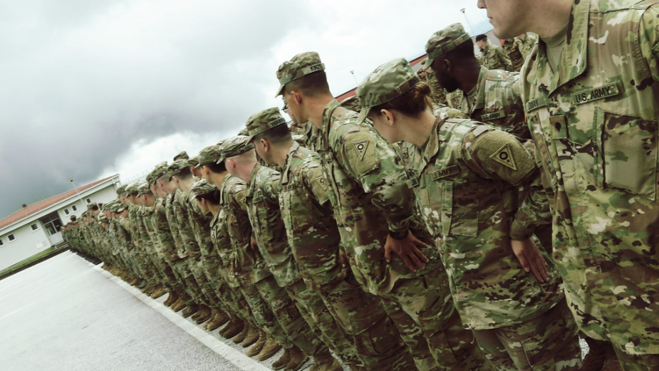
“Dress Right Dress!” Business “Professional” Casual

Slide 2
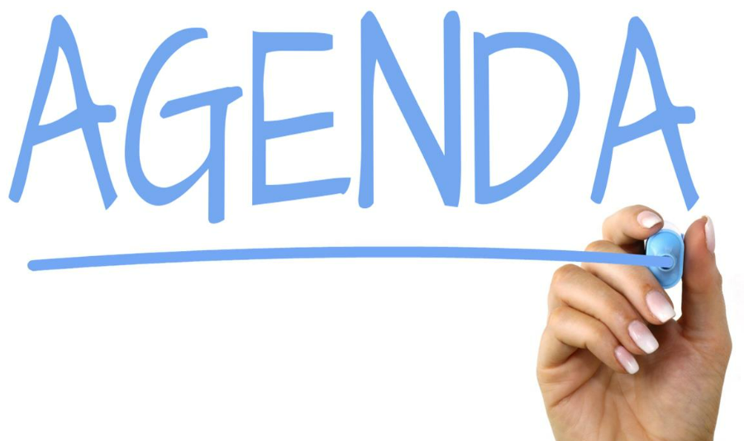
AR 670-1
Business casual defined
Business casual ideas
Tips for business casual dress codes
Common mistakes and what not to wear
When to wear business causal attire
Questions

Slide 3
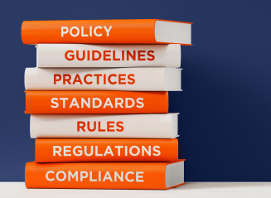
Army Regulation 670-1
Civilian clothing is authorized for wear when off duty, unless the wear is prohibited by the senior commander.
Army personnel will present a professional image that does not detract from the profession, unless specifically exempted by the commander for specific mission requirements.
Soldiers will ensure that their dress and personal appearance are commensurate with the high standards traditionally associated with Army service
When civilian clothing has been authorized by competent authority for wear in a duty status in lieu of a uniform, the civilian clothing will be of the same comparable degree of formality as the uniform prescribed for such duty. Standards of dress and appearance will be conservative and meet the same high standards established for personnel in uniform.
All Soldiers will comply with hair, fingernail, and grooming policies while in any military uniform, or in civilian clothes on duty. [AR 670-1, para 3-2a]
Females will comply with the cosmetics policy while in any military uniform or while in civilian clothes on duty. [AR 670-1, para 3-2b(4)]
Soldiers are authorized to wear only one item on each wrist while in uniform or in civilian clothes on duty. [AR 670-1, para 3-4a]
No jewelry, other than that described in paragraphs 3–4a or 3–4d, can appear exposed while in uniform, or in civilian clothes on duty [AR 670-1, para 3-4b]
Ankle bracelets, toe rings, necklaces (other than those described in para 3 – 15), faddish (trendy) devices, medal-lions, amulets, and personal talismans or icons are not authorized for wear while in uniform or in civilian clothes on duty. [AR 670-1, para 3-4e]

Slide 4
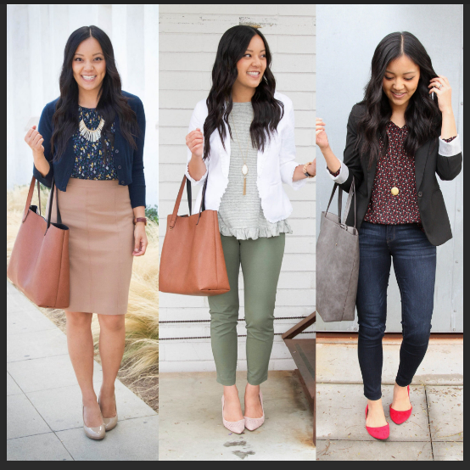
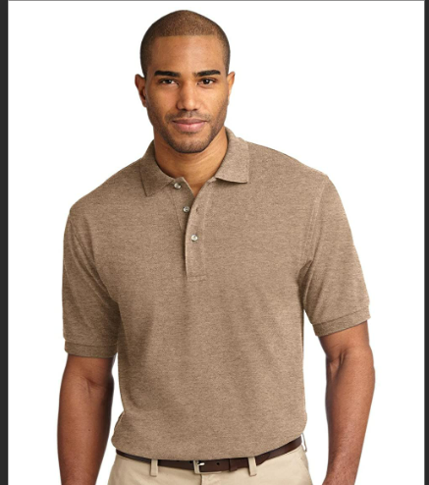
What is Business Casual?
Relating to or denoting a style of clothing that is less formal than traditional business wear but is still intended to give a professional and businesslike impression.

Slide 5
Business Casual Ideas
Slacks or business dress pants, khakis, chinos, knee-length skirts, dark jeans without holes
Button-down shirts, sweaters, blouses, henleys or polo shirts
Modest knee-length or maxi dresses
Optional cardigans, blazers or sport coats (especially for the colder months)
Closed-toed shoes such as Oxfords, boots, mules, loafers, lifestyle sneakers (with leather or canvas) pumps or flats
Simple, professional accessories such as scarves, belts or jewelry
Note: Articles of clothing must be ironed/pressed/wrinkle-free

Slide 6
Tips for Business Casual Dress Codes
Plan ahead. Don’t put together your next business casual look from what you find at the edges of your closet. Plan a business casual look that you both feel comfortable and confident in, but that also clearly meets the expectations of your workplace.
Don’t limit the applications to business. An excellent business casual outfit or item can work nicely as a more formal or dressy option in many social settings.
Enjoy the latitude but don’t push the limits.
Appearances are always important—it’s how people will remember you—co-workers and clients.

Slide 7
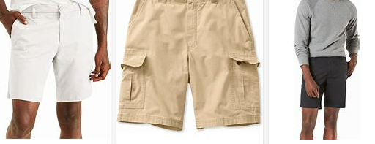
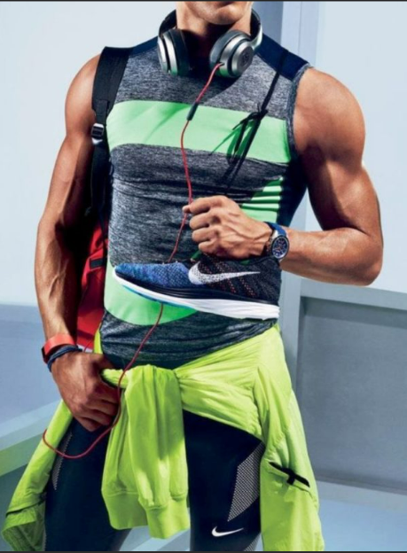
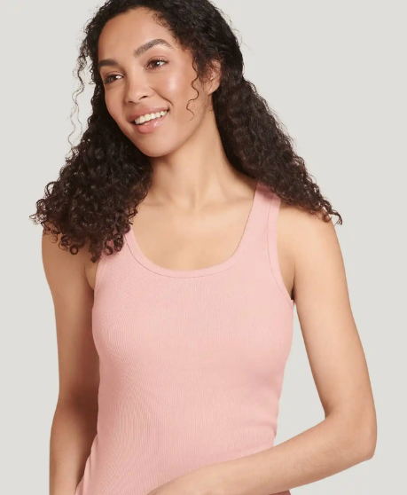
Common Mistakes & What Not To Wear
Clothing that is oversized or too loose
Shorts
Tank tops or strapless shirts unless paired with a blazer, jacket or cardigan
Backless or low-cut tops
Joggers or sweatpants
Crop tops
Clothing with inappropriate logos or text
No Belt - Always tuck in a shirt that does not have an even waistline. Note that you can only do this properly if you have a belt.
Workout clothes - You might be most comfortable wearing what you would wear to the gym around town but, once again, this is a workplace standard.
Well-worn athletic sneakers or tennis shoes
Flip-flops, Crocs, or slides
Stained or wrinkled clothing
Clothing with holes, such as distressed jeans
Clothing that is too tight or short
Bonnet,

Slide 8
When to Wear Business Casual Attire
In and around the OSJA, when conducting business
In and around the Bdes’ footprint, when conducting business
Magistrate Court
Courts-Martial
Teleworking (Video Communication)
Off post meetings and interviews
Official military ceremonies when Army uniforms or formal civilian attire are not required:
Graduations
Change of command/responsibility
Deployment/Redeployment ceremonies
Award ceremonies
Inductions ceremonies
And suchlike…

Slide 9
Questions?

